Slide 1
Equality and Diversity

Slide 2
Contents
What is Equality and Diversity
The Equality Act
Types of Discrimination
Direct Discrimination
Indirect Discrimination
Protected Characteristics

Slide 3
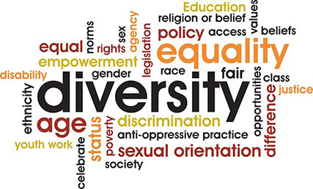
What is Equality and Diversity?
Equality is about ensuring everybody has an equal opportunity, and is not treated differently or discriminated against because of their characteristics.
Diversity is understanding the differences between people and groups of people, and placing a positive value on those differences.

Slide 4
The Equality Act 2010
The Equality Act 2010 legally protects people from discrimination in the workplace and in wider society.
It replaced previous anti-discrimination laws with a single Act, making the law easier to understand and strengthening protection in some situations.
It sets out the different ways in which it’s unlawful to treat someone.

Slide 5
Direct Discrimination
This is when you are treated worse than another person or other people because:
you have a protected characteristic,
someone thinks you have that protected characteristic (known as discrimination by perception),
you are connected to someone with that protected characteristic (known as discrimination by association)
Indirect Discrimination
Indirect discrimination happens when there is a policy that applies in the same way for everybody but disadvantages a group of people who share a protected characteristic, and you are disadvantaged as part of this group. If this happens, the person or organisation applying the policy must show that there is a good reason for it.

Slide 6
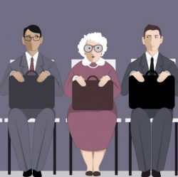
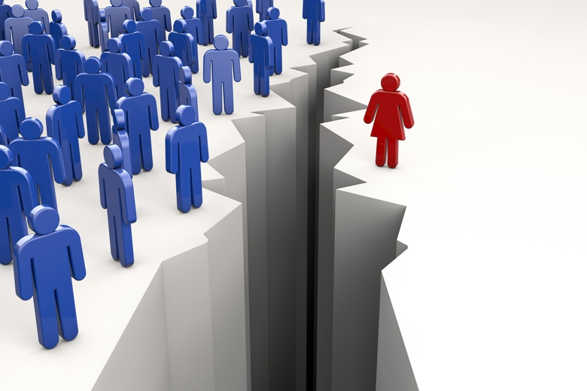
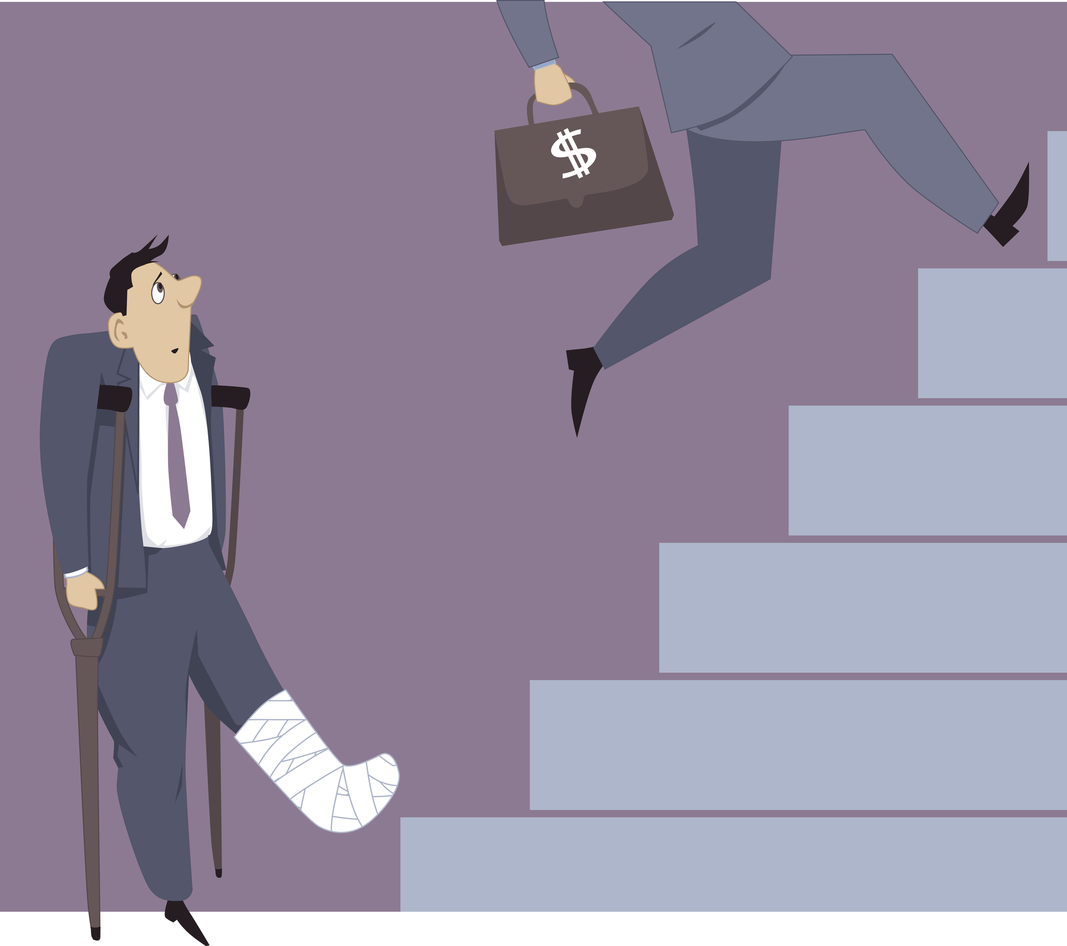
Protected Characteristics
The following characteristics are known as protected characteristics
Age discrimination in the workplace is the practice of letting a person's age unfairly become a factor when deciding who receives a new job, promotion, or other job benefits. Decisions about terminating employees also cannot be solely based on their age.
Sex discrimination is where a person is treated unfairly because they are a man or a woman. It applies to men and women of any age and therefore includes girls and boys.
Disability Discrimination is when a person with a disability is treated less favourably than a person without a disability. They are treated this way for a reason arising from their disability, and the treatment cannot be justified.

Slide 7
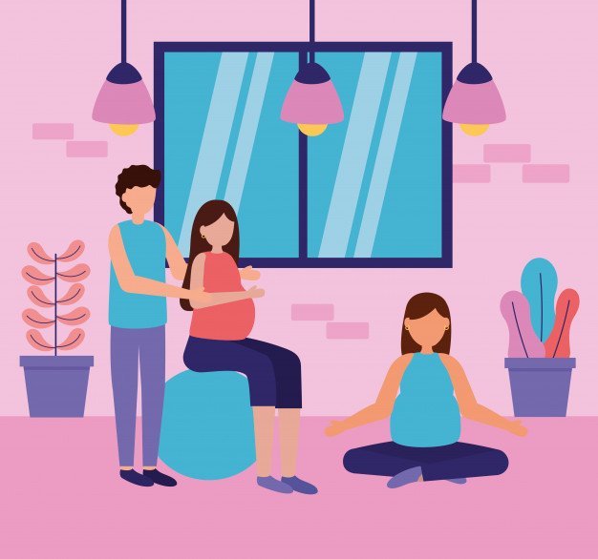
Additional Protected Characteristics
Additional Characteristics include:
Gender reassignment
Marriage and civil partnership
Pregnancy and maternity
Race
Religion or belief
Sexual orientation

Slide 8
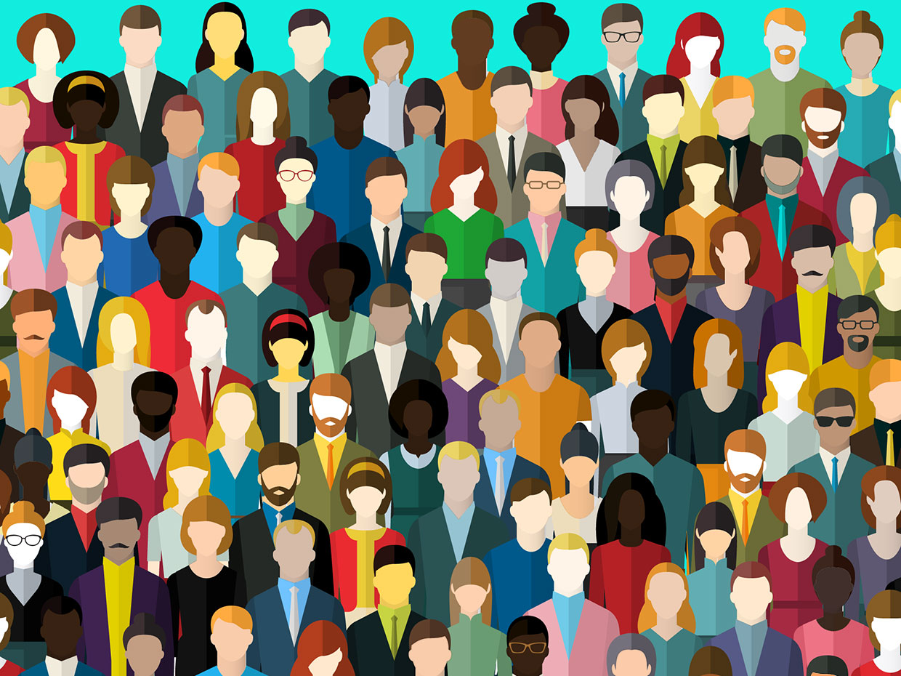
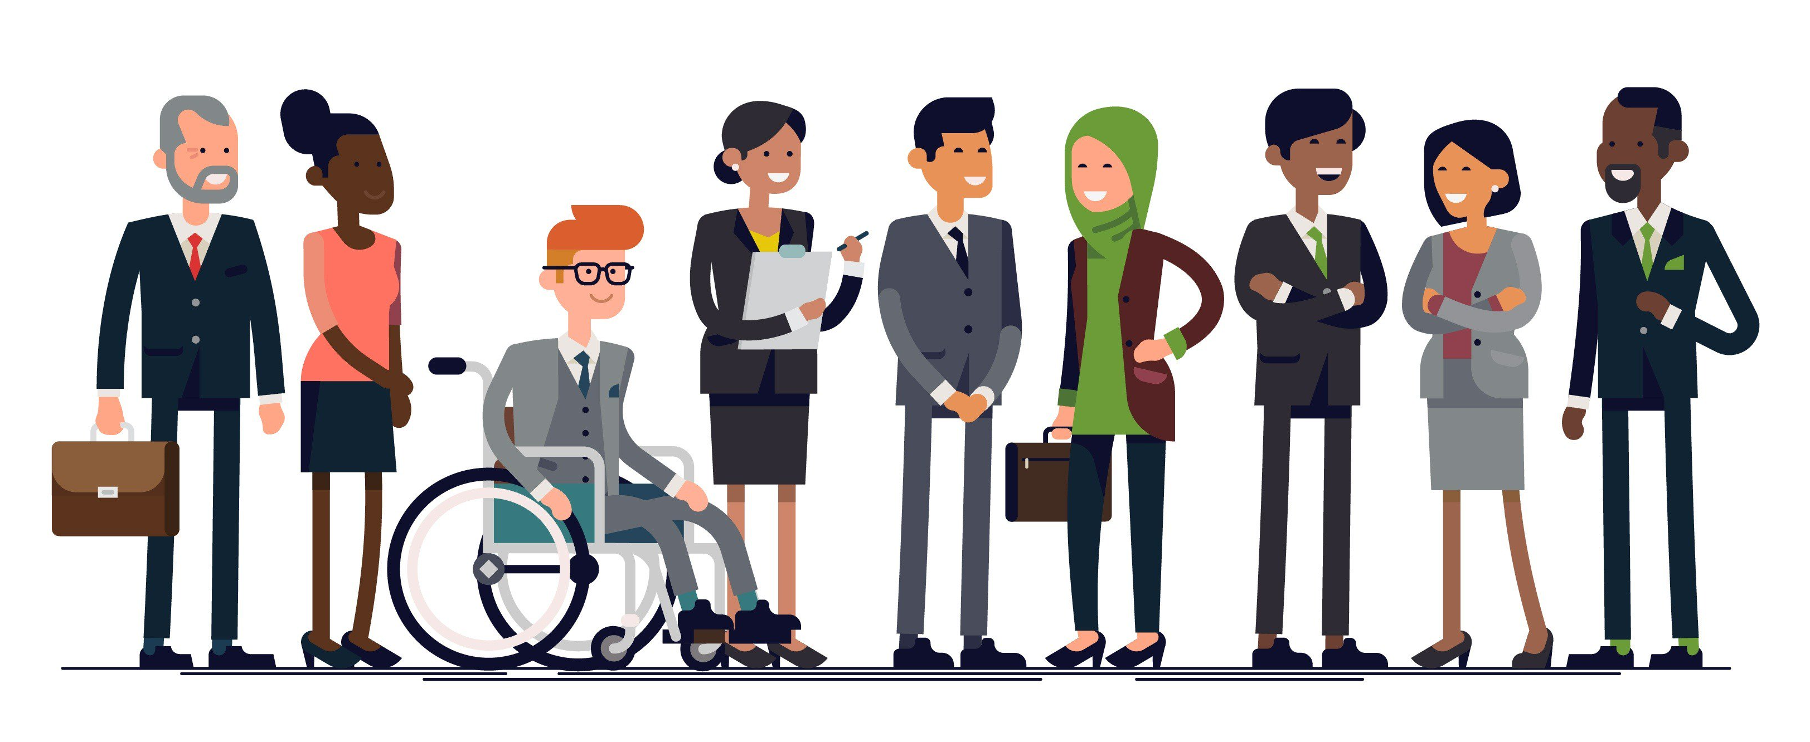
Diversity
Diversity is about celebrating and valuing how different we all are. This is strongly linked with promoting human rights and freedoms, based on principles such as dignity and respect.
Diversity is about recognising, valuing and taking account of people's different backgrounds, knowledge, skills, and experiences, and encouraging and using those differences to create a productive and effective workforce.
Diversity is something that applies to everyone, and should be part of everything we do. It is an important part of our work and not just a side issue. It requires everyone to play a full part. It is important to recognise that none of us fit neatly into separate ‘packages’ which can be neatly labelled or discriminated against.

Slide 9
Summary
At MVRRS we incorporate equality into our core objectives, making every effort to eliminate discrimination, create equal opportunities and develop good working relationships between different people.
We aim to promote equality, diversity and inclusion by working within the sector to create a more diverse workforce.

